Slide 1
Fake it ‘till you make it
Generating synthetic data
Erik-Jan van Kesteren
Thom Volker
Utrecht University
ODISSEI Social Data Science team

Slide 2
thomvolker.github.io/OSWS_Synthetic

Slide 3
Imagine..

Slide 4




Notes:
Imagine you’re a researcher. Maybe a social scientist with a great idea about how our physical environment influences our spending patterns.
Scientist by Justicon from <a href="https://thenounproject.com/browse/icons/term/scientist/" target="_blank" title="Scientist Icons">Noun Project</a>
Idea by Icon Master from <a href="https://thenounproject.com/browse/icons/term/idea/" target="_blank" title="Idea Icons">Noun Project</a>
house tree by LUTFI GANI AL ACHMAD from <a href="https://thenounproject.com/browse/icons/term/house-tree/" target="_blank" title="house tree Icons">Noun Project</a>
Euro by Larea from <a href="https://thenounproject.com/browse/icons/term/euro/" target="_blank" title="Euro Icons">Noun Project</a>

Slide 5
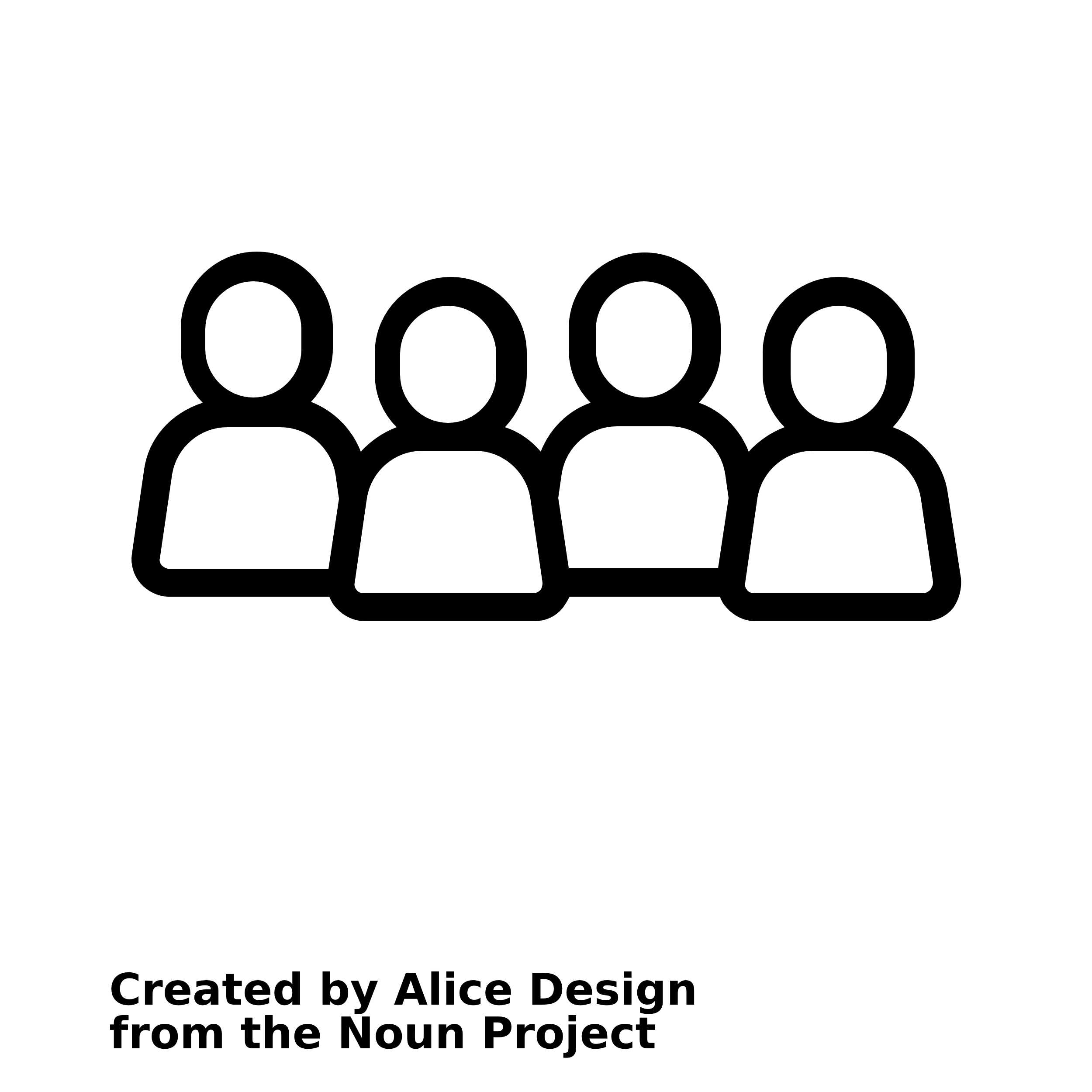
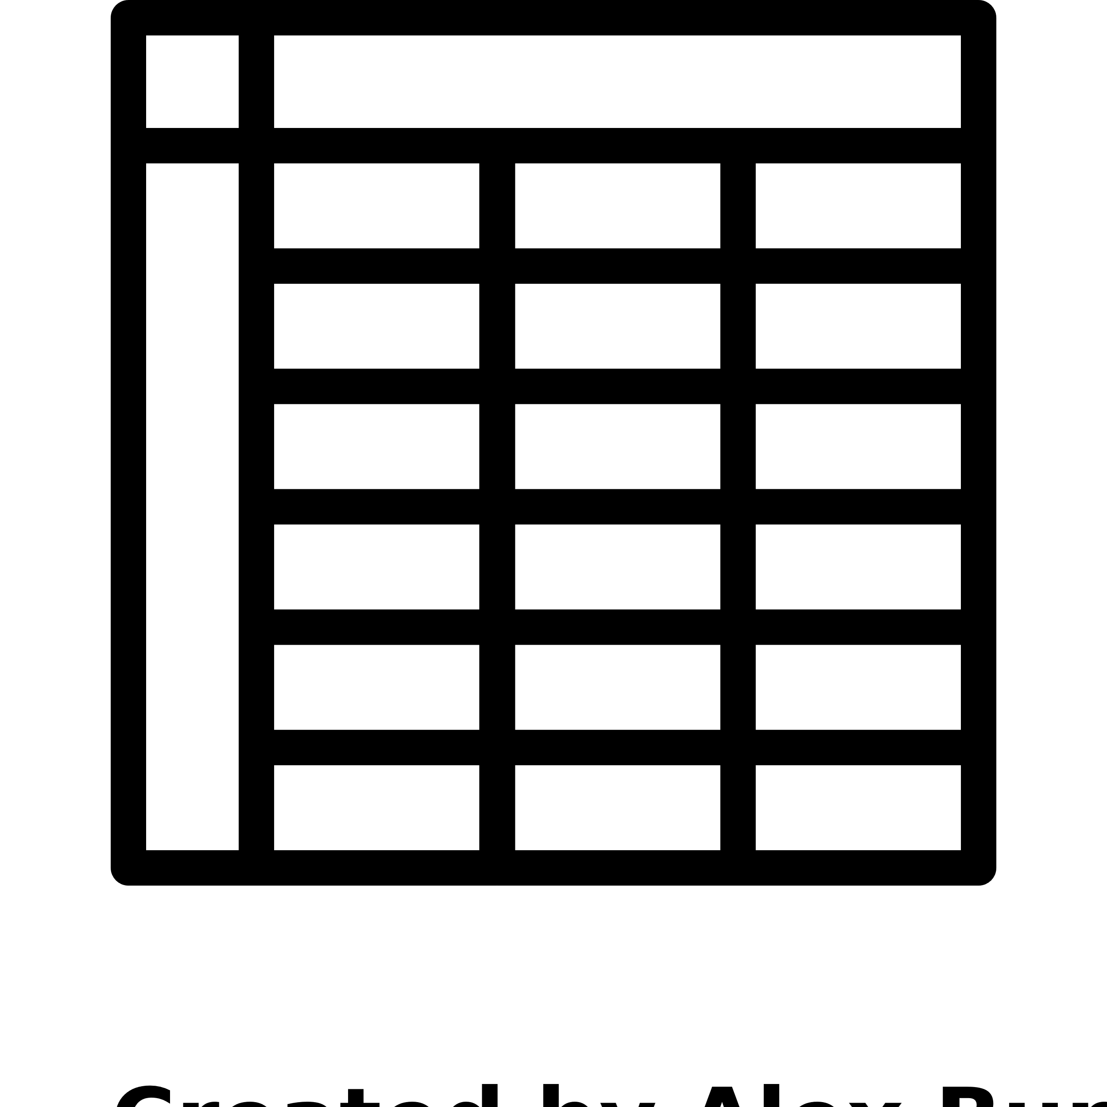
Where do you live?
How long have you lived there?
What do you earn?
How much do you spend on gifts for your friends?
Notes:
So you ask a large group of people a few questions and you record it in a data file.
Scientist by Justicon from <a href="https://thenounproject.com/browse/icons/term/scientist/" target="_blank" title="Scientist Icons">Noun Project</a>
Idea by Icon Master from <a href="https://thenounproject.com/browse/icons/term/idea/" target="_blank" title="Idea Icons">Noun Project</a>
house tree by LUTFI GANI AL ACHMAD from <a href="https://thenounproject.com/browse/icons/term/house-tree/" target="_blank" title="house tree Icons">Noun Project</a>
Euro by Larea from <a href="https://thenounproject.com/browse/icons/term/euro/" target="_blank" title="Euro Icons">Noun Project</a>
people by Alice Design from <a href="https://thenounproject.com/browse/icons/term/people/" target="_blank" title="people Icons">Noun Project</a>
Table by Alex Burte from <a href="https://thenounproject.com/browse/icons/term/table/" target="_blank" title="Table Icons">Noun Project</a>

Slide 6
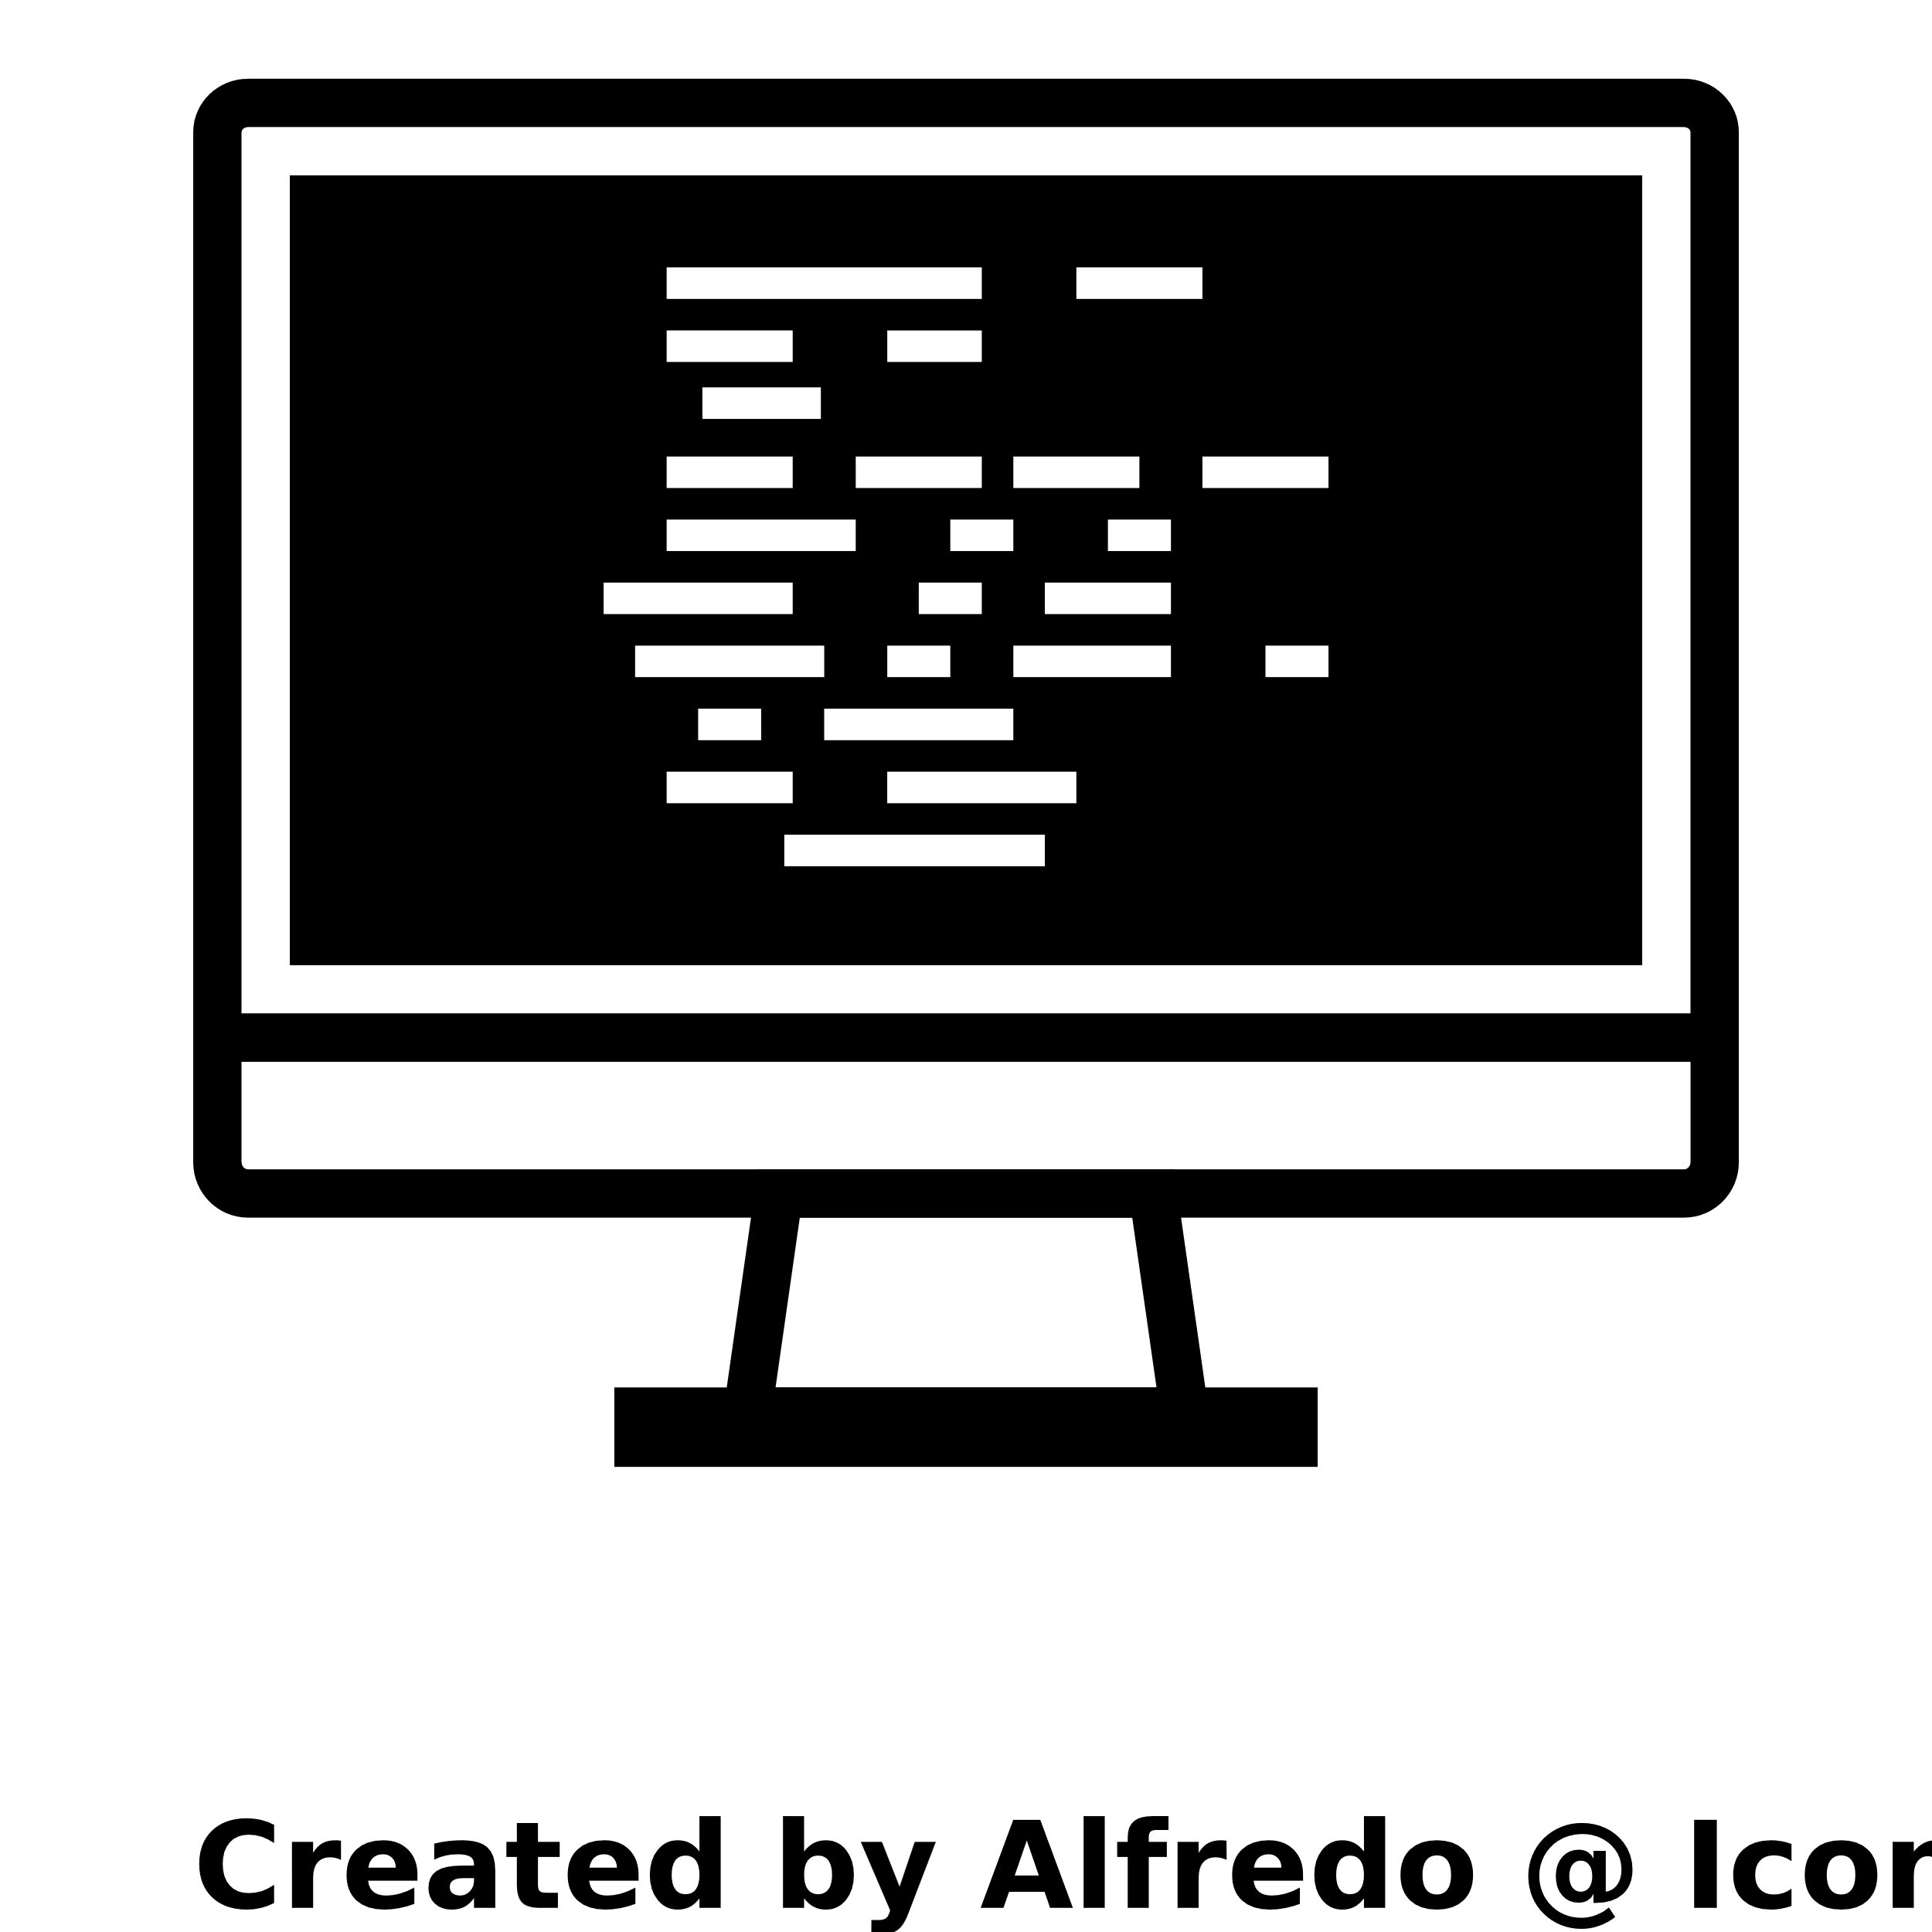
Notes:
Then, you take your data file and write this awesome complicated script that processes it and produces an answer to your question
Hacking by Alfredo @ IconsAlfredo.us from <a href="https://thenounproject.com/browse/icons/term/hacking/" target="_blank" title="Hacking Icons">Noun Project</a>

Slide 7
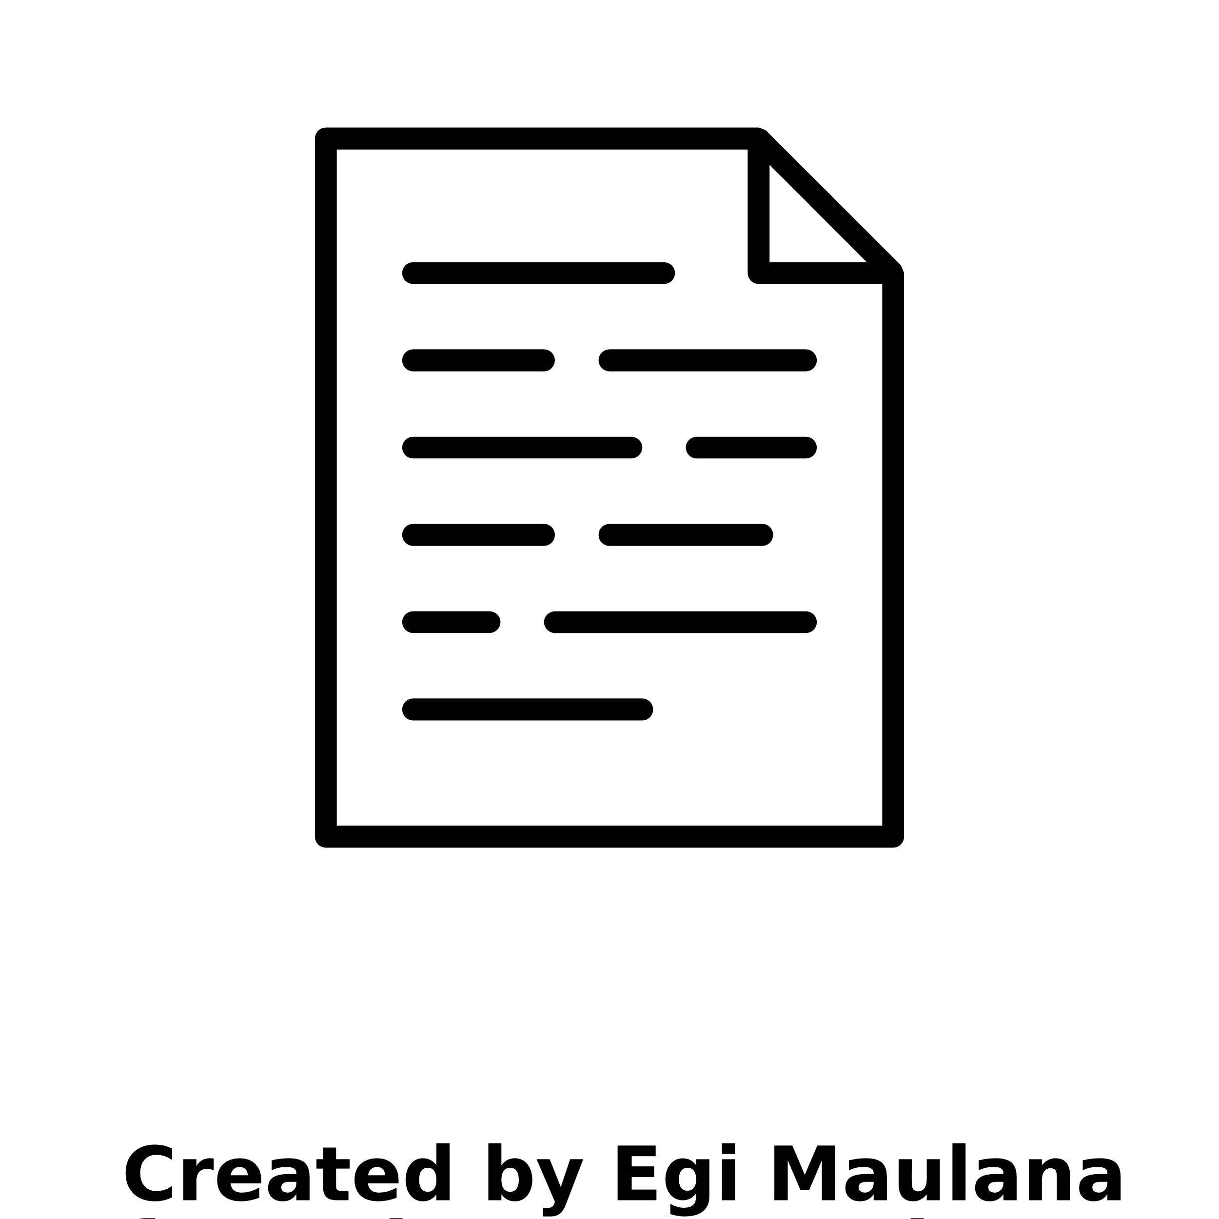


“More generous gifting behaviour in
greener neighbourhoods”
Notes:
Paper by Egi Maulana from <a href="https://thenounproject.com/browse/icons/term/paper/" target="_blank" title="Paper Icons">Noun Project</a>

Slide 8

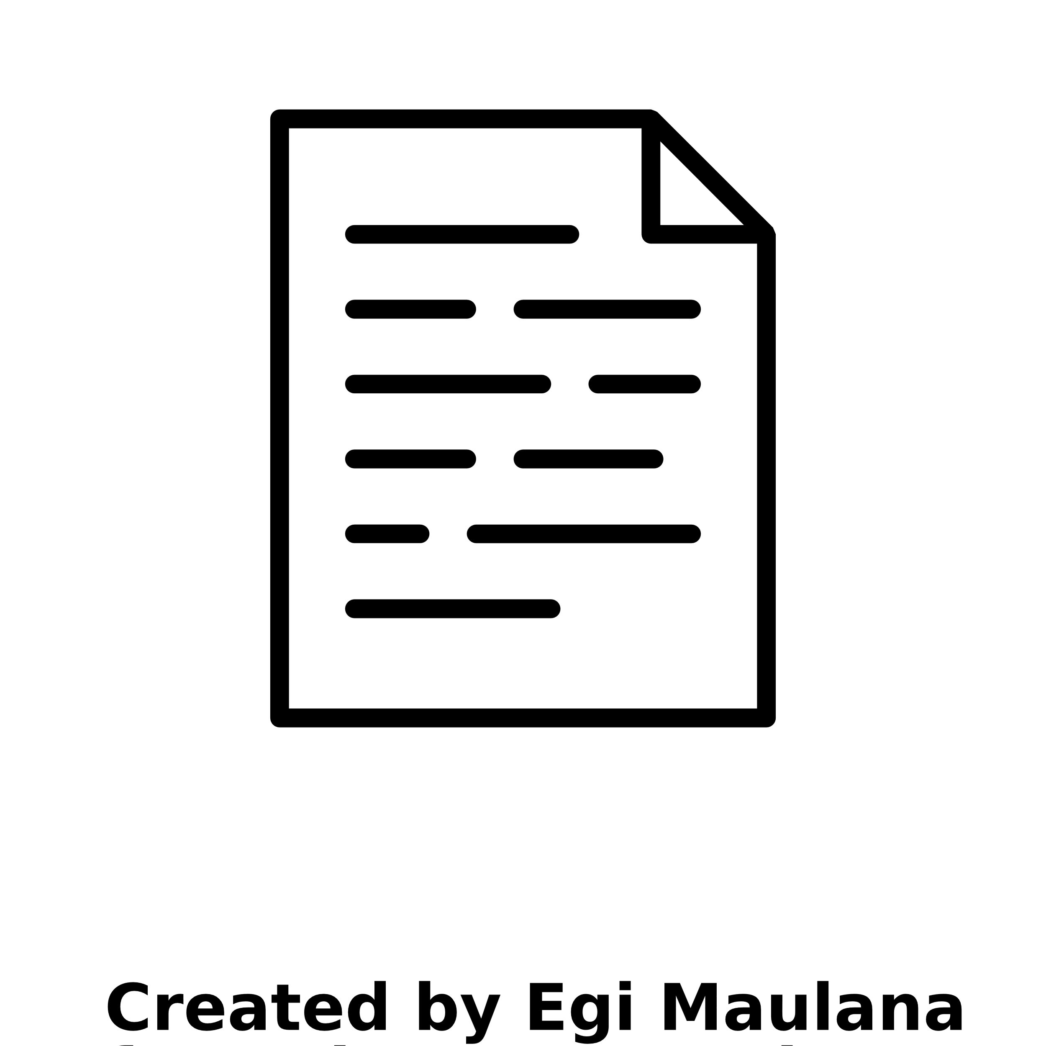

Notes:
Scientist by Justicon from <a href="https://thenounproject.com/browse/icons/term/scientist/" target="_blank" title="Scientist Icons">Noun Project</a>
Question by Anggara Putra from <a href="https://thenounproject.com/browse/icons/term/question/" target="_blank" title="Question Icons">Noun Project</a>

Slide 9
my_data <- read_csv("super_private_data_file.csv")

Slide 10
Open data not allowed, options:
Data just not available, good luck
“Data available upon reasonable request”
Data is part of a large project with data access procedures
I just want to check out the script to learn from the cool analysis!
Solution: publish open synthetic data with your open materials

Slide 11
What will we do in this tutorial?
Lecture
A primer on synthetic data
Practical
Creating synthetic data in R
Lecture
Privacy & utility for synthetic data
Practical
Assessing utility & disclosure control in R

Slide 12
A primer on synthetic data

Slide 13
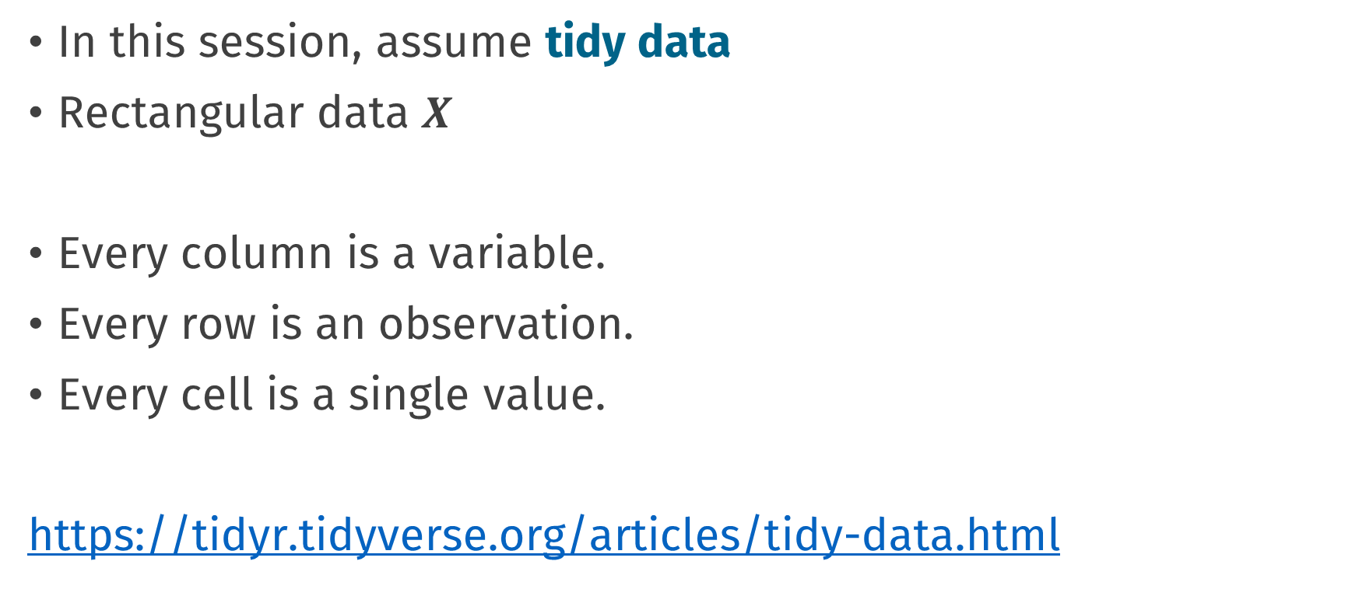
Preface: tidy data
In this session, assume tidy data
Rectangular data $X$
Every column is a variable.
Every row is an observation.
Every cell is a single value.
https://tidyr.tidyverse.org/articles/tidy-data.html

Slide 14
Synthetic data (EJ’s definition)
Synthetic data is generated from a model
As opposed to real, natural, collected data
fake data
generated data
simulated data
digital twin
public use file

Slide 15
To create synthetic data, you need a generative model

Slide 16
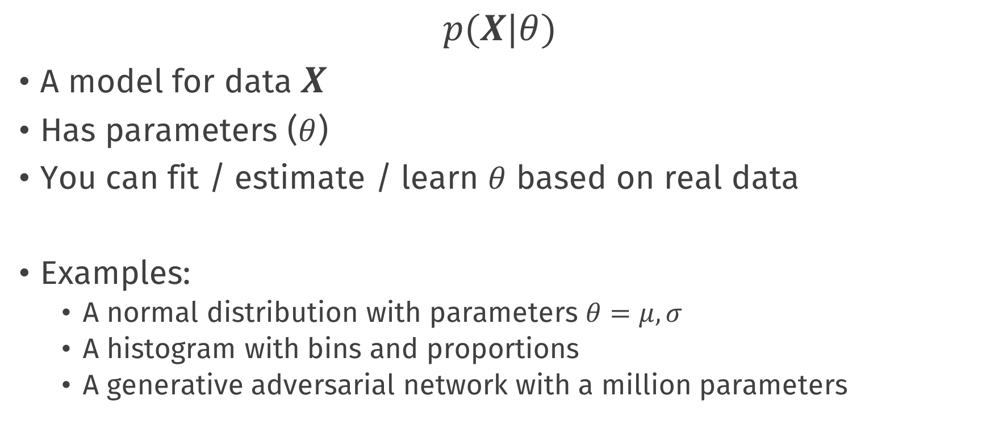
Generative model
$$p(X|θ)$$
A model for data $X$
Has parameters ($θ$)
You can fit / estimate / learn $θ$ based on real data
Examples:
A normal distribution with parameters $θ=μ, σ$
A histogram with bins and proportions
A generative adversarial network with a million parameters

Slide 17
Generative model
In R code:
# parameters
mu <- 1.0
sigma <- 1.5
# generate data
x_sim <- rnorm(100, mean = mu, sd = sigma)

Slide 18
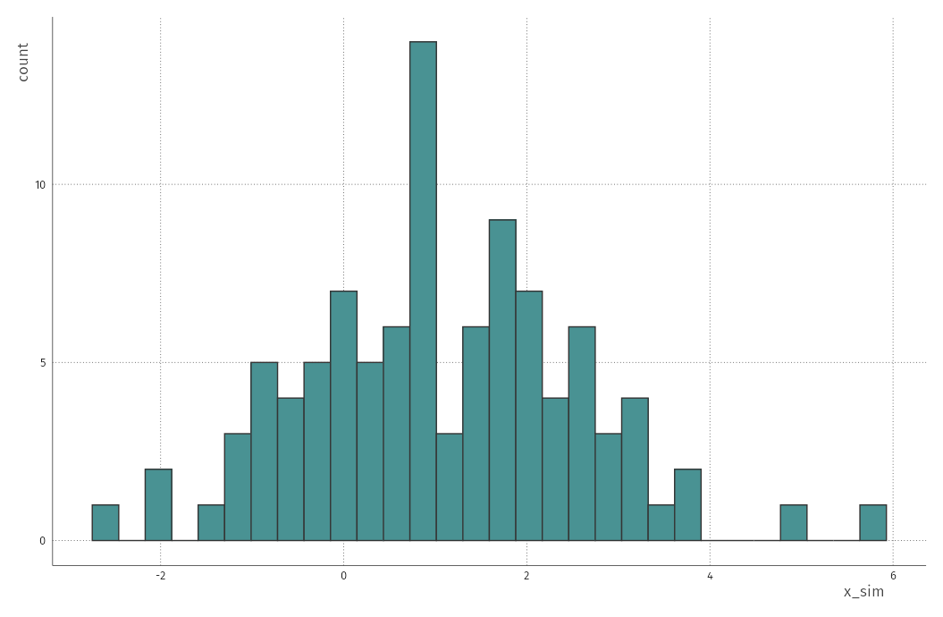

Slide 19
Generative model
Today we will fit two types of generative models:
Parametric: Assume that variables (conditionally) follow a certain distributions (e.g., Bernoulli, Normal, Exponential, …)
Non-parametric: Do not assume certain distributions, use a machine learning® method
There are infinitely many more generative models. This is an active field of research

Slide 20
Software
There are many ways creating generative models & synthetic data
Manually creating a csv file ☺
Metasynth (https://github.com/sodascience/metasynth)
Synthpop (https://synthpop.org.uk/)
MICE (https://amices.org/mice/)
Synthetic Data Vault (https://sdv.dev/)
DataSynthesizer (https://github.com/DataResponsibly/DataSynthesizer)

Slide 21
Software
There are many ways creating generative models & synthetic data
Manually creating a csv file ☺
Metasynth (https://github.com/sodascience/metasynth)
Synthpop (https://synthpop.org.uk/)
MICE (https://amices.org/mice/)
Synthetic Data Vault (https://sdv.dev/)
DataSynthesizer (https://github.com/DataResponsibly/DataSynthesizer)

Slide 22
The MICE generative model

Slide 23
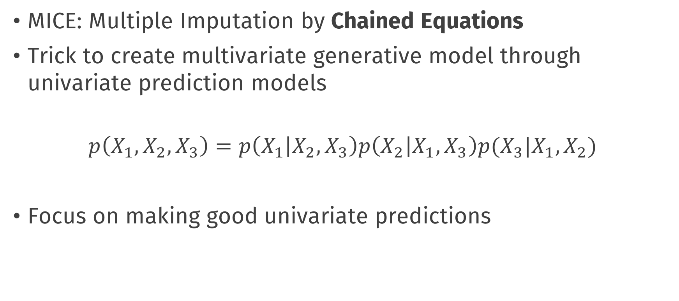
The MICE generative model
MICE: Multiple Imputation by Chained Equations
Trick to create multivariate generative model through univariate prediction models
$$p\left(X_{1}, X_{2},X_{3}\right)=p\left(X_{1} | X_{2},X_{3}\right)p\left(X_{2} | X_{1}, X_{3}\right)p(X_{3}|X_{1}, X_{2})$$
Focus on making good univariate predictions

Slide 24
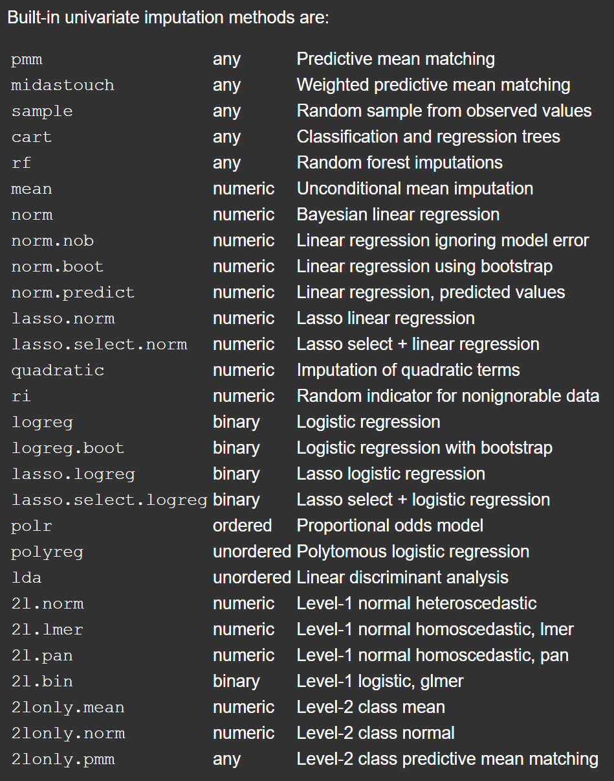
The MICE generative model
Many prediction methods available in MICE, we will use two types:
Parametric
Linear & Logistic regression
Nonparametric
Classification and regression trees

Slide 25
Let’s get started!

Slide 26
Icons from the noun project
Scientist by Justicon
Idea by Icon
house tree by LUTFI GANI AL ACHMAD
Euro by Larea
people by Alice Design
Table by Alex Burte
Hacking by Alfredo
Paper by Egi Maulana
Scientist 2 by Justicon
Question by Anggara Putra
https://thenounproject.com/

Slide 27
Conclusions

Slide 28
Default light slide
Default subheading
This is the body of the text
Default subheading
Note that the text is not black, but “black, text 1, lighter 25%”
Default subheading
This makes things easier on the eyes
Default subheading
This is the body of the text

Slide 29
Is this an impact slide?

Slide 30
Default light slide
This is the body of the text

Slide 31
Default dark slide
Default subheading
The dark slide brings some variation
Default subheading
It can highlight important aspects of the presentation.
Default subheading
This is the body of the text
Default subheading
This is the body of the text

Slide 32
Is this an impact slide?

Slide 33
Here is an impactful slide with a sentence on it.
Here is a topic related to the aforementioned question.

